Slide 1
Welcome
2nd Network Virtual Conference
November 2nd 2022

Slide 2
Conference Programme – morning session
Kent and Medway Pathology Network
TIME | TOPIC | SPEAKER
1100 | Conference opening and chair for the morning | Amanda Price Workforce Project Director Kent and Medway Pathology Network
1110 | Mentoring for leadership | Amanda Price Workforce Project Director Kent and Medway Pathology Network
1135 | Kent and Medway Healthcare Science Network | Mark Knight Strategic Healthcare Scientist Sonali Soysah Integrated Training and Development Project Manager Kent and Medway ICB
1200 | Journey to a Maturing Network | Malcolm Nudd Director of Pathology Transformation Kent and Medway Pathology Network
1230 | Neurodiversity in the workplace | Dr Jo Horne Pathology Workforce Education Lead Southern Counties Pathology (SCP)
1300 | BREAK FOR LUNCH

Slide 3
Conference Programme – afternoon session
Kent and Medway Pathology Network
TIME | TOPIC | SPEAKER
1330 | Chair for the afternoon | Catherine Lorenzen Education and Training Coordinator
1330 | Making the change from CAT to Capture | Sue Mitchell Chief Biomedical Scientist, Blood Transfusion EKHUFT
1350 | Microbiomes of Urine & the Prostate are Linked to Human Prostate Cancer Risk Groups | Emma Meader Consultant Clinical Scientist Microbiology EKHUFT
1410 | PET ratio | Rebecca Mole Biomedical Scientist Biochemistry MTW
1430 | QFIT Analysis | Dave Parris Senior Biomedical Scientist Biochemistry MTW
1440 | Q&As | Caroline Fowles Education and Training Coordinator
1450 | Conference Closing

Slide 4
Getting the most out of our conference
Kent and Medway Pathology Network
Mute mic until you want to ask a question
Cameras optional
Questions/comments at the end of each presentation in the morning and at the end of the afternoon session
Use the hands up icon to ask a question or pop it in the chat
Evaluation matters – link in the chat at the end of the event
Session is recorded and slides and recording available on HCS network site on NHS Futures

Slide 5
MENTORING FOR LEADERSHIP
Amanda Price – Workforce Project Director
Network Virtual Conference
November 2nd 2022

Slide 6
Mentoring – a recap
Kent and Medway Pathology Network
Mentors share their experiences of working in a similar field
Ongoing relationship that can last for a long time
Can be more informal with meetings taking place when the mentee needs some space and time to think, guidance or support
Focus on long-term career and personal development
The agenda is set by the mentee and takes a broader view of the person
The process of mentoring encourages independence, autonomy and self-development
Through reflective practice, shared learning and improved ownership for solution-focused thinking, mentoring can deliver improvements in an individual’s performance

Slide 7
Mentoring offers
Kent and Medway Pathology Network
South East Leadership and Lifelong Learning Team
Coaching and
Mentoring Register
IBMS mentoring scheme
IBMS Mentoring Scheme - Institute of Biomedical Science
Reciprocal Mentoring DGT
Reverse Mentoring
MTW
Mentoring as part of leadership development
EKHUFT
Healthcare Science Network mentoring
markknight@nhs.net

Slide 8
Pathology Network Workforce Workshop
Kent and Medway Pathology Network
Leadership development through
involvement in network projects
Mentoring as a development
opportunity for staff at all levels –
-leadership
-career development
-scientific/clinical

Slide 9
What is Reciprocal Mentoring?
Kent and Medway Pathology Network
Mutually beneficial mentoring partnership with formal support, training and facilitation.
Opportunity to self-direct the content of their mentoring sessions to make it as relevant and meaningful as possible.
Benefits for the mentees:
Building a partnership with someone at a senior level
Opportunity to tap into the experience of their mentor
Insight into senior level activities and the ways in which leaders make decisions
Greater awareness of self and organisational systems through the relationship that is formed
Confidence in talking to and challenging peers

Slide 10
What is Reciprocal Mentoring?
Kent and Medway Pathology Network
Benefits for the mentors:
Challenge from a different perspective
Increased understanding of the ways in which their behaviours, beliefs, policies and practices impact upon the lived experience of people within the Trust
Confidence in challenging beliefs and behaviours with peers and influencing decision making
Motivating others to take action that would make a change for mentees

Slide 11
Personal Stories
Kent and Medway Pathology Network
Patrick and Sonali share their
experiences of mentoring and
how their mentors
benefited as well as them
This Photo by Unknown Author is licensed under CC BY-SA-NC

Slide 12
Proposed KMPN mentoring programme
Decision tree and expressions of interest with line manager agreement in December
Two hour group intro on Teams in January – choice of 3 dates
Identify your goals
Refresh communication skills for effective mentoring on-line
Reflective diary to record learning
Matching, ‘chemistry’ conversation and contracts in Jan/Feb
Monthly 1h mentoring sessions February to July
Evaluation at start, mid point and end
Your stories published on website and/or bulletin

Slide 14
ROADSHOWS
Your chance to hear the latest network news and plans,
share your ideas on our network vision, values and
communications, and ask us any questions
Malcolm Nudd, Director of Pathology Transformation
and Amanda Price, Workforce Project Director

Slide 15
ROADSHOW DATES
Kent and Medway Pathology Network
Day | Date | Time | Site | Speciality/ies
Tuesday | 1.11.22 | All day | WHH | All
Tuesday | 8.11.22 | am | QEQM | All
Tuesday | 8.11.22 | Pm | K&C | All
Thursday | 17.11.22 | 8.30-2 | Maidstone | Blood Sciences Microbiology
Wednesday | 23.11.22 | am | Maidstone | Cell path
Wednesday | 23.11.22 | pm | TW | All
 | TBC |  | Dartford | All
 | TBC |  | Medway | All

Slide 16
Why is a formal pathology network important for Kent and Medway?
Kent and Medway Pathology Network
Increase in demand and complexity
Workforce shortages
Lack of space
Financial challenges as a health and care system
Future funding focused on networks e.g. digital
Direction of integrated care

Slide 17
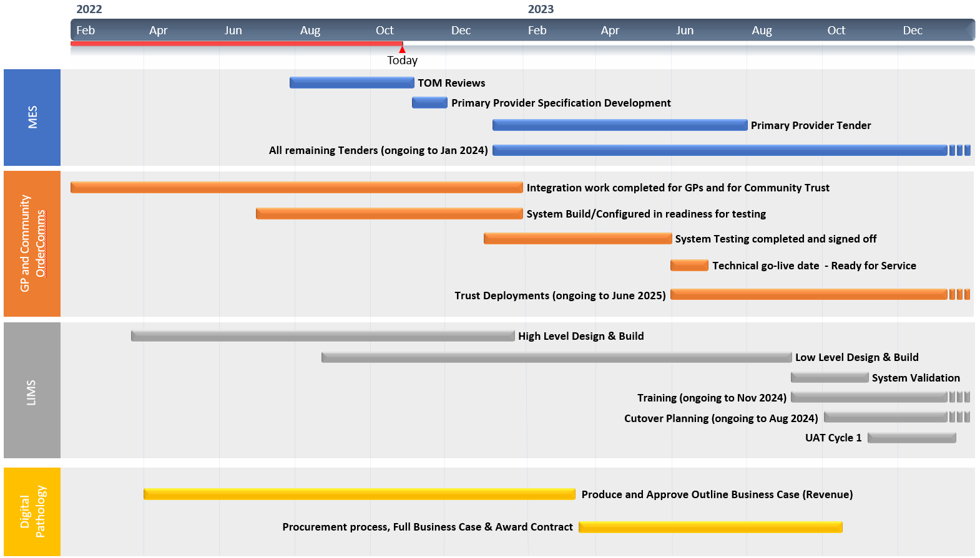
2022
2022
Today
High-level Programme plan to Jan 2024

Slide 18
Milestones by March 2023
Kent and Medway Pathology Network
Recommitment of Trust Boards to network plans
KMPN vision for single operating model agreed
Collaboration agreement to include decision making, matrix management and accountability including role of Trusts and ICB SROs; independence from Trusts on workforce terms and conditions and job descriptions; risk and reward to include origin of GP work; business development; common quality policy.
Appointment of additional roles of clinical director and managing director for the network,
Appointment of Interim quality lead and interim clinical discipline leads from existing pathology workforce
Equality, diversity and inclusion and leadership development action plans in place
PQAD in use on all sites, single quality policy and quality improvement programme

Slide 19
Milestones by March 2023
Kent and Medway Pathology Network
Network brand and plan for joint recruitment
Employing from a diverse pool
Reciprocal mentoring programme
Associate practitioner development
Registration portfolio academy
Identify staff for clinical career progression
Pilot review of job tasks to make sure staff can work at their full set of skills and competencies

Slide 20
The 7 Domains that characterise a Pathology Network are:
Governance | A single governance model signed off by all network member Trust and ICS Boards, with clear clinical and operational leadership arrangements where dissolution would require Trust Board approval
Leadership | A single accountable officer appointed at network level e.g. Network SRO, and other leadership roles defined and appointed to
Operational | Operational consolidation of services at agreed sites and integration into clinical pathways and business models signed off by Trust Boards
Quality | A common quality management process and methodology for oversight of performance, quality and clinical governance including working with local, regional and national systems such as PQAD and single UKAS accreditation process.
IT and digital | A digital roadmap setting out how the network will achieve digital interoperability across the whole local healthcare system and digitization of cellular pathology services with shared digital pathology reporting.
Workforce | Agreed workforce strategy for passporting/mobility, Skill mix (including the role of clinical scientists), training and CPD and recruitment and retention, managed via a Network workforce lead
Shared supply chain | A shared joint procurement strategy with robust supply chain and joint purchasing at scale for example shared Managed Service Contract across the network, or a clear process and timeline to achieve one.

Slide 21
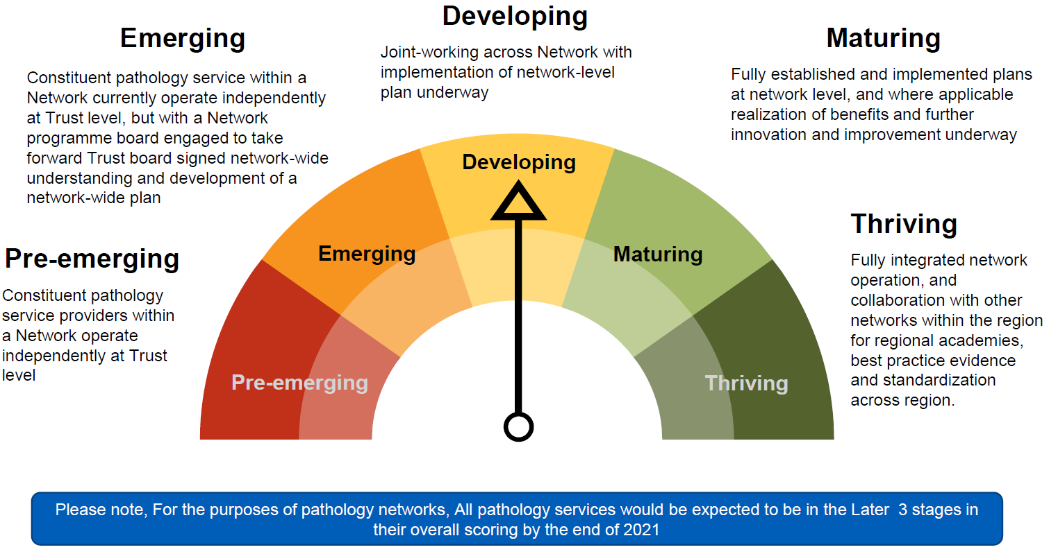
NHSE Maturity Index
Kent and Medway Pathology Network
Where we need to be by March 2023
Where we need to be by March 2025
Where we are now

Slide 22
Our Developing Vision – what should this be
Kent and Medway Pathology Network
A thriving and sustainable pathology service provided by an outstanding team, enabled by cutting edge equipment and I.T.
‘There is a place in the network for everyone’
What about patients?

Slide 23
Our Values and Behaviours
Kent and Medway Pathology Network
What is your expectation of working in the network?
What are our expectations of each other working together in the network?
What do you think our patients expect?
What do you think the wider Kent and Medway health and care system expects?

Slide 24
Communications
Kent and Medway Pathology Network
 | CONTINUE | START | STOP
Internal comms (pathology)
External comms

